Slide 2
THE THESIS STATEMENT
What is a thesis?
How do you write a thesis?
What makes a good thesis?

Slide 3
What is a thesis?

Slide 4
WHAT IS A THESIS?
A historical interpretation, supported by evidence.
A roadmap for your project.
Usually about 50 words.

Slide 5
CHARACTERISTICS OF A THESIS
Discusses significance
More than just facts
Specific
Connects to the theme
Notes:
Next slides talk about each of these.

Slide 6
SIGNIFICANCE
Discusses “so what?”
Why is your topic important in history?

Slide 7
SIGNIFICANCE
Discusses “so what?”
Why is your topic important in history?
“Jackie Robinson was a great baseball player.”
“Jackie Robinson broke the color barrier, making it possible for African Americans to play professional sports.”
Notes:
Fact, does not get at “So what”

Slide 8
MORE THAN JUST FACTS
Uses the facts to come up with your own idea about why your topic is important.

Slide 9
MORE THAN FACTS
Uses the facts to come up with your own idea about why your topic is important.
“George Washington was the first president of the United States.”
“The United States gained its independence from Great Britain because of George Washington’s military leadership.”
Notes:
For example, you could argue against this by saying that the US won the Revolutionary War not because of Washington, but because Great Britain was in decline.”

Slide 10
SPECIFIC
FOCUSED.
Addresses a specific topic and makes an argument about a specific impact in history.

Slide 11
SPECIFIC
FOCUSED.
Addresses a specific topic and makes an argument about a specific impact in history.
“Martin Luther King, Jr. changed everyone’s lives forever.”
“Martin Luther King, Jr.’s ‘I Have a Dream’ speech brought national attention to the Civil Rights Movement.”

Slide 12
CONNECT TO THEME

Slide 13
1919 WORLD SERIES SCANDAL
Looking for: Significance, Goes Beyond Facts, Specific, Theme Connection
During the 1919 World Series, eight players were accused of throwing games.
Notes:
Fact, doesn’t get at significance

Slide 14
1919 WORLD SERIES SCANDAL
Looking for: Significance, Goes Beyond Facts, Specific, Theme Connection
During the 1919 World Series, eight players were accused of throwing games.
During the 1919 World Series, eight players were accused of throwing games, resulting in the appointment of a baseball
commissioner.
Notes:
fact and significance but no theme relation yet

Slide 15
1919 WORLD SERIES SCANDAL
Looking for: Significance, Goes Beyond Facts, Specific, Theme Connection
During the 1919 World Series, eight players were accused of throwing games.
During the 1919 World Series, eight players were accused of throwing games, resulting in the appointment of a baseball
commissioner.
During the 1919 World Series, eight players were accused of intentionally losing games. The scandal made the public lose confidence in the game, so they appointed a commissioner with the responsibility to regulate the game and the right to ban players.

Slide 16
How do you write a thesis?

Slide 17
WRITING YOUR THESIS
Don’t let the
thesis statement
intimidate you!

Slide 18
WRITING YOUR THESIS
Research
Analysis
Presentation
Start at the right point in the
History Day process.

Slide 19
WRITING YOUR THESIS
You are going to go through several drafts before you get it right.

Slide 20
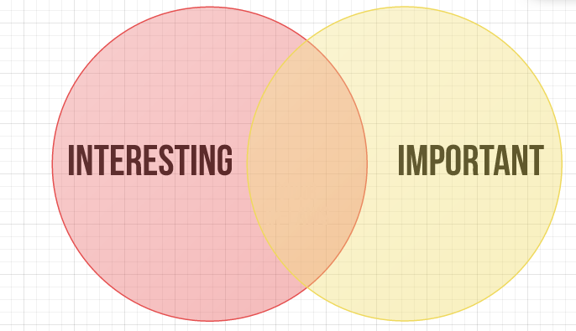
WRITING YOUR THESIS
You’re going to have to make
some tough decisions.

Slide 21
For example.

Slide 22
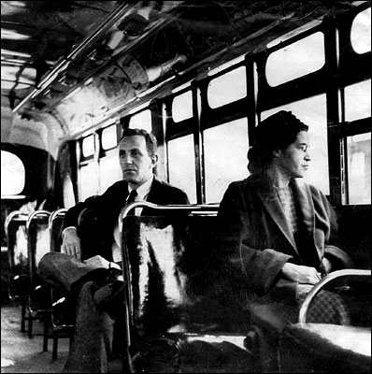
ROSA PARKS AND THE BUS BOYCOTT

Slide 23
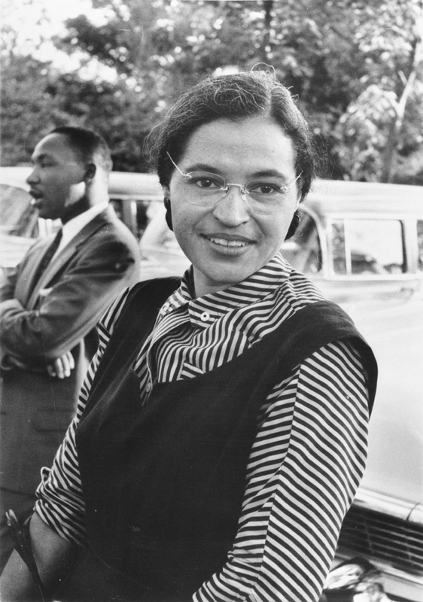
INTERESTING OR IMPORTANT?
Her parents were James and Leona McCauley
On December 1, 1955 Parks refused to give up her bus seat to make room for a white passenger
Born in Tuskegee, Alabama on February 4, 1913
Parks was a devout Christian

Slide 24
Getting started.

Slide 25
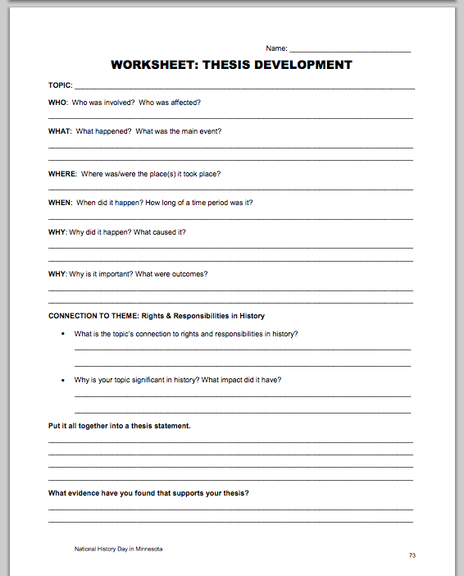
Thesis Development Worksheet
Answer basic questions.
Pull together into a draft thesis.

Slide 26
THESIS DEVELOPMENT WORKSHEET
Topic:
Rosa Parks and the Montgomery Bus Boycott

Slide 27
THESIS DEVELOPMENT WORKSHEET
WHO: Who was involved? Who was affected?
Rosa Parks; citizens in Montgomery, Alabama; civil rights leaders, Montgomery’s city government officials.

Slide 28
THESIS DEVELOPMENT WORKSHEET
WHAT: What happened? What was the main event? Rosa Parks refused to give up her bus seat to a white passenger, which violated a law enforcing segregation on Montgomery city buses. She was arrested and went to jail. Civil rights leaders, including Martin Luther King, Jr., organized a boycott of buses and challenged the law as
unconstitutional.

Slide 29
THESIS DEVELOPMENT WORKSHEET
WHERE: Where was/were the place(s) it took place?
Montgomery, Alabama

Slide 30
THESIS DEVELOPMENT WORKSHEET
WHEN: When did it happen? How long of a time period was it?
Parks was arrested on Dec. 1, 1955; the boycott
started on Dec. 5 and lasted for 382 days.

Slide 31
THESIS DEVELOPMENT WORKSHEET
WHY: Why did it happen? What caused it?
Civil rights leaders wanted to overturn segregation laws.

Slide 32
THESIS DEVELOPMENT WORKSHEET
WHY: Why is it important? What were the outcomes?
The boycott forced change in Montgomery and succeeded in overturning the law requiring segregation on public transportation. This success inspired other civil rights protests and helped Martin Luther King, Jr. develop his non-violent strategies to fight segregation.

Slide 33
THESIS DEVELOPMENT WORKSHEET
THEME CONNECTION: Rights & Responsibilities in History - What is the topic’s connection to rights and responsibilities in history?
African Americans asserted their civil rights under the 14th Amendment and sought to break down segregation in the south. Civil rights activists like Rosa Parks and Martin Luther King, Jr. took on the responsibility of challenging the city of Montgomery. City leaders were responsible for upholding existing laws and maintaining segregation.

Slide 34
THESIS DEVELOPMENT WORKSHEET
THEME CONNECTION: Rights & Responsibilities in History - Why is your topic significant in history? What impact did it have?
Before the Montgomery Bus Boycott, the impact of the Brown v. Board of Education Supreme Court decision was limited to the segregation of schools. Civil rights leaders used the Montgomery Bus Boycott to expand the protection of equal rights to public transportation. This effectively ended the "Separate but equal" standard established in the Plessy v. Ferguson decision. The success of the boycott inspired other challenges to segregation and was a turning point in the Civil Rights Movement as new leaders, like Martin Luther King, Jr., emerged from the struggle in Montgomery.

Slide 35
THESIS DEVELOPMENT WORKSHEET
Put it all together!
In 1955, Rosa Parks took the responsibility for creating a civil rights confrontation when she refused to give up her bus seat to a white passenger in Montgomery, Alabama. The resulting bus boycott and a successful Supreme Court lawsuit demonstrated the effectiveness of non-violent
economic protest and legal strategies in securing equal rights.

Slide 36
DOES IT ANSWER “W” QUESTIONS?
In 1955, Rosa Parks took the responsibility for creating a civil rights confrontation when she refused to give up her bus seat to a white passenger in Montgomery, Alabama. The resulting bus boycott and a successful Supreme Court lawsuit demonstrated the effectiveness of non-violent
economic protest and legal strategies in securing equal rights.
Who, What, When, Where, Why

Slide 37
SO WHAT?
In 1955, Rosa Parks took the responsibility for initiating a civil rights confrontation when she refused to give up her bus seat to a white passenger in Montgomery, Alabama. The resulting bus boycott and a successful Supreme Court lawsuit demonstrated the effectiveness of non-violent
economic protest and legal strategies in securing equal rights.
How did this topic change history?

Slide 38
HOW LONG?
In 1955, Rosa Parks took the responsibility for initiating a civil rights confrontation when she refused to give up her bus seat to a white passenger in Montgomery, Alabama. The resulting bus boycott and a successful Supreme Court lawsuit demonstrated the effectiveness of non-violent
economic protest and legal strategies in securing equal rights.
53 words

Slide 39
THEME CONNECTION
In 1955, Rosa Parks took the responsibility for initiating a civil rights confrontation when she refused to give up her bus seat to a white passenger in Montgomery, Alabama. The resulting bus boycott and a successful Supreme Court lawsuit demonstrated the effectiveness of non-violent
economic protest and legal strategies in securing equal rights.
Rights/Responsibilities

Slide 40
What makes a good thesis?

Slide 41
USE THEME WORDS

Slide 42
THESIS STATEMENT TIPS
“In 1941 Japan
bombed us.”
?
Don’t use first person.

Slide 43
THESIS STATEMENT TIPS
“In 1941 Japan bombed Pearl Harbor. Why do you think they would do that?”
?
Don’t ask questions in your thesis.
Answer them!

Slide 44
THESIS STATEMENT TIPS
“It is 1941 and Japan is bombing Pearl Harbor.”
?
Don’t use present tense.

Slide 45
THESIS STATEMENT TIPS
“President Lincoln should
have fought for
abolition earlier.”
?
Avoid using “should” in your thesis.
This is a historical argument, not philosophy.

Slide 46
THESIS STATEMENT TIPS
“If Lincoln hadn’t freed the slaves, we would still have slavery in America.”
?
Watch out for “what if” history.
Focus on what actually happened.

Slide 47
THESIS STATEMENT TIPS
“Without Winston Churchill, the whole world would be controlled by the Nazis.”
Watch out for “what if” history.
Focus on what actually happened.

